Slide 1
COMPUTER ORGANIZATION AND ARCHITECTURE
Dr. Rizwan Khan
Head – Department of Computer Science and Engineering
(An NBA Accredited Program)
ABES Institute of Technology, Ghaziabad

Slide 2
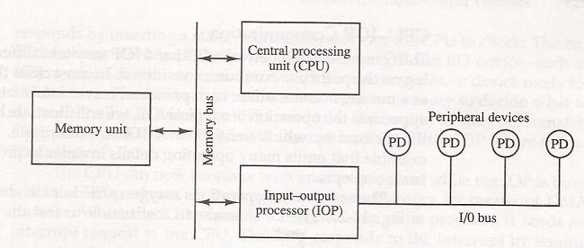
IOP

Slide 3
CHANNEL / CPU COMMUNICATION
Input/Output Processor
CPU operations
IOP operations
Send instruction
to test IOP.path
Transfer status word
to memory
If status OK, then send
start I/O instruction
to IOP.
Access memory
for IOP program
CPU continues with
another program
Conduct I/O transfers
using DMA;
Prepare status report.
I/O transfer completed;
Interrupt CPU
Request IOP status
Transfer status word
Check status word
to memory location
for correct transfer.
Continue

Slide 4
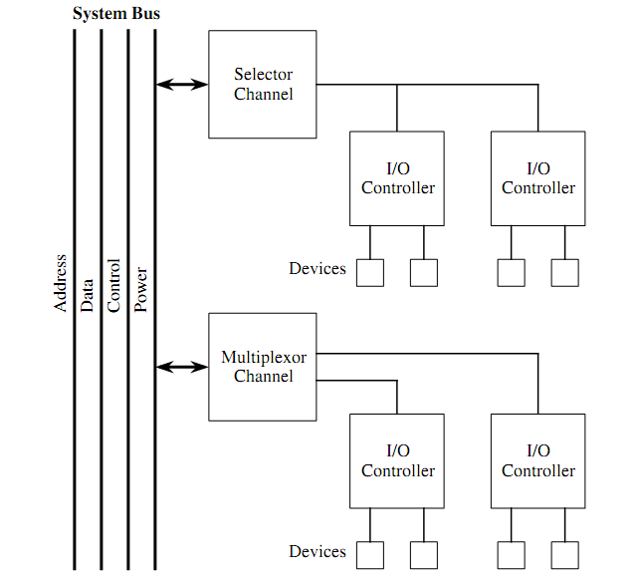
IOP Types
A Selector Channel controls several devices, but handles transfers for a single device at a time.
A selector channel is typically used for high speed devices like hard disks.
A multiplexor channel handles transfers for several devices at a time.
A multiplexor channel comes in two forms:
a byte multiplexor, which interleaves bytes from a number of low speed devices into a single stream,
block multiplexor, which interleaves blocks from a number of high speed devices into a single stream.

Slide 5


